Slide 1


HOTEL BOOKING DEMAND
A Minor Project Report
in partial fulfillment of the degree
Bachelor of Technology
in
Computer Science & Artificial Intelligence
2003A52094 A.Saicharan Reddy
2003A52095 G.Manikanta Reddy
2003A52073 K.Saikumar
By
Under the Guidance of
Mrs.L.Mounika Asst. Prof. CSE Department
Submitted to
SCHOOL OF COMPUTER SCIENCE & ARTIFICIAL INTELLIGENCE
SR UNIVERSITY, ANANTHASAGAR, WARANGAL
April, 2023.

Slide 2
ABSTRACT:
➔The growth of online distribution has grown by 46% from 2014 to 2018. The hold has shifted from manual bookings to online travel agencies by almost 68% in 2018. The hospitality industry is facing issues in revenue generation due to ease of cancellations of the bookings made. Based on the data collected in 2018, almost 40% of the revenue is cancelled before arrival. This comes with the possibility of easy online bookings and their cancellations. It has become crucial to perform an analysis to help the industry to maximize its revenue generation and predict false bookings and probable cancellations in order to use their resources judiciously.

Slide 3
PROBLEM STATEMENT:
Predict whether a booking will be canceled or not to allow the hotel’s manager to make better decisions in order to improve overbooking strategies and cancellation policies.

Slide 4
EXISTING SYSTEM: Reservation is done via phone calls or by visit in person to the hotel reservation office. The guest’s personal details such as Name, gender, Age and Duration of visit or stay, are entered during booking made.
PROPOSED SYSTEM:
Based on the above-mentioned reasons, we propose an system for a hotel booking system. The main idea of the proposed expert system is to interconnect the hotel with places, activities and interesting events around, and based on user preferences to suggest suitable hotel services and suitable activities for the hotel guest.

Slide 5
OBJECTIVES DESCRIPTION:
Provide people seeking hotel rooms with accurate information about available accommodations.
Allow booking of rooms without errors and without creating conflicts.
To maximize occupancy
To provide up to date information about the status of reservations
To allow staff to easily update information in the system, and have the system inform everyone who needs to know

Slide 6
LITERATURE SURVEY:
A. Predicting Hotel Bookings Cancellation with a Machine Learning Classification:
Booking cancellation is a very common thing in today’s world, which can cause severe losses to the business owners. This paper describes how AI is used to identify which booking can be cancelled and prevent some losses.
B.Rising rate of Cancellation in the Hotel Industry:
The growing trend of Hotels Industry is beneficial for Hotels but there are some problems too such as Rising Rate of Cancellation. The user cancels the booking of the hotel after seeing the reviews given by the people who booked the hotel already.
C.Aspect based Sentiment Oriented Summarization of Hotel Reviews
The reviews and the feedbacks of the customer play an important role in the image as well as the revenue system of the hotel. But most of the travelers don't read all reviews. The system analyzes the reviews and feedback by the customers.

Slide 7
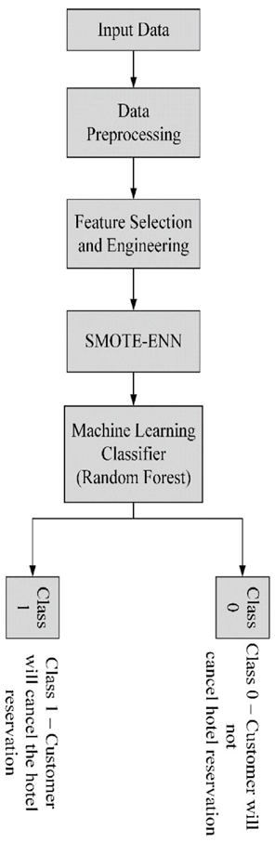
OVERALL ARCHITECTURE:

Slide 8
DATASET DESCRIPTION: This dataset is taken from UCI Machine Learning Repository. This dataset contains 32 columns and 87230 rows. It contains 32 attributes, contains 492 null values .
DATASET INFORMATION:
→The data is originally from the article Hotel Booking Demand Datasets, written by Nuno Antonio, Ana Almeida, and Luis Nunes for Data in Brief, Volume 22, February 2019.
→This data set contains booking information for a city hotel and a resort hotel, and includes information such as when the booking was made, length of stay, the number of adults, children, and/or babies, and the number of available parking spaces, among other things.

Slide 9
ATTRIBUTES INFORMATION:
hotel
is_canceled
lead_time
arrival_date_year
arrival_date_month
arrival_date_week_number
arrival_date_day_of_month
stays_in_weekend_nights
stays_in_week_nights
Babies
Meal
Country
market_segment
distribution_channel
is_repeated_guest

Slide 10
previous_cancellations
previous_bookings_not_canceled
reserved_room_type
assigned_room_type
booking_changes
deposit_type
Agent
Company
days_in_waiting_list
customer_type
adr
required_car_parking_spaces
total_of_special_requests
reservation_status
reservation_status_date

Slide 11
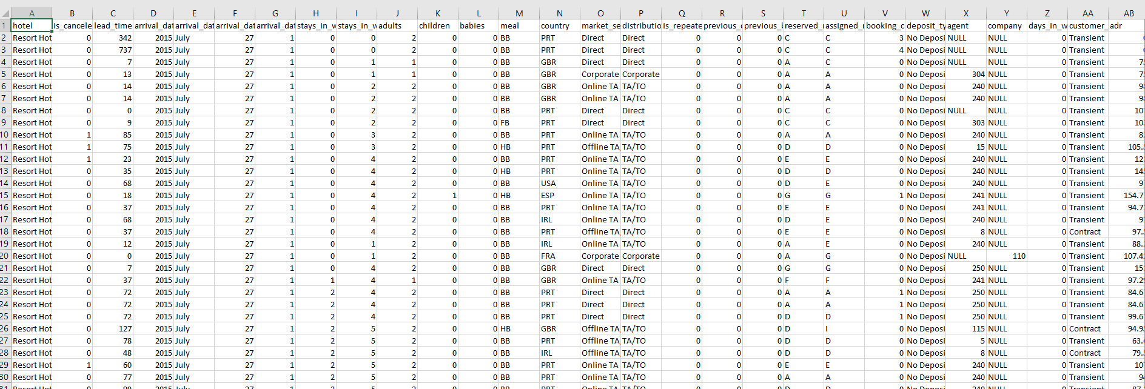

Slide 12
DECISION TREE:
Decision Tree is the most powerful and popular tool for classification and prediction. A Decision tree is a flowchart-like tree structure, where each internal node denotes a test on an attribute, each branch represents an outcome of the test, and each leaf node (terminal node) holds a class label.
Decision trees are used to solve classification problems and categorize objects depending on their learning features. They can also be used for regression problems or as a method to predict continuous outcomes from unforeseen data.
A decision tree is a way of modeling outcomes and decisions with each decision in the branching structure representing a different branch. It is used to calculate the success potential of various resolutions to achieve a specific goal.

Slide 13
RANDOM FOREST:
Random forest is a commonly-used machine learning algorithm trademarked by Leo Breiman and Adele Cutler, which combines the output of multiple decision trees to reach a single result. Its ease of use and flexibility have fueled its adoption, as it handles both classification and regression problems.
The term “random decision forest” was first proposed in 1995 by Tin Kam Ho. Ho developed a formula to use random data to create predictions. Then in 2006, Leo Breiman and Adele Cutler extended the algorithm and created random forests as we know them today. This means this technology, and the math and science behind it, are still relatively new.

Slide 14
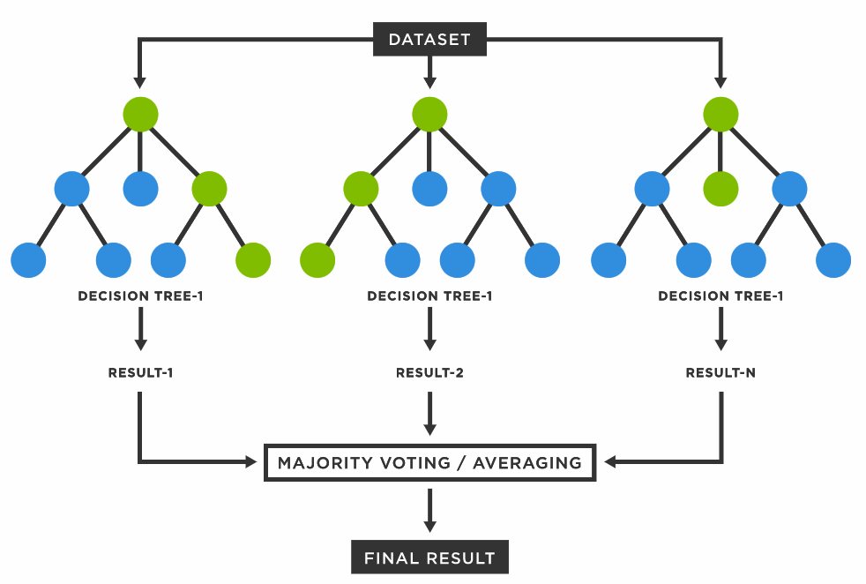

Slide 15
RESULT:
By using classification random forest algorithm we got
→Random Forest Metrics
→Accuracy: 0.7692994946533769
→Precision: 0.9968216130313866 Recall: 0.37828872973991706 f1_score: 0.5484452702333461
By using classification decision tree algorithm we got
→Decision Tree Metrics
→Accuracy: 0.769076137029902
→Precision 0.9962241653418124 Recall 0.3779117979645684 f1_score 0.5479586817511067

Slide 16
CONCLUSION:
In this study, we compared the performance of the random forest and decision tree algorithms for classification. The results indicate that both algorithms achieved a similar accuracy of around 77%. However, the precision and recall metrics for the random forest algorithm were slightly better than the decision tree algorithm, with a precision score of 0.9968 and a recall score of 0.3783, compared to a precision score of 0.9962 and a recall score of 0.3779 for the decision tree algorithm. The f1_score metric was also slightly higher for the random forest algorithm at 0.5484, compared to 0.5480 for the decision tree algorithm. Overall, the random forest algorithm appears to perform slightly better than the decision tree algorithm for this classification task.

Slide 17
REFERENCES:
(PDF) Hotel Revenue Management – A Critical Literature Review (researchgate.net)
Role of Online Reviews in Hotel Reservations Intention Based on Social Media (scialert.net)
A Literature Review About Online Hotel Booking System | PDF | Innovation | Tourism (scribd.com)
Modeling customer satisfaction in online hotel booking – ScienceDirect
Hotel online pricing policy: A review and a regional case study (redalyc.org)
Literature review for a hotel management system Free Essays | Studymode
(DOC) HOTEL MANAGEMENT INFORMATION SYSTEM PROJECT FINAL | Gideon Babatunde - Academia.edu
Literature Review On Hotel Management | ipl.org
Literature review on Hotel industry and service quality - THIS IS TO GO IN THE HOTELS SECTION Choi, - Studocu
literature review on hotels (pdfprof.com)
(DOC) Chapter 2 REVIEW OF RELATED LITERATURE AND STUDIES This chapter presents the review of related literature and studies particularly on the Proposed Computerized Hotel Management System of | jesrael samira - Academia.edu

Slide 18
THANK YOU

